Slide 1





GLA UNIVERSITY
Computer Network

Slide 2

Multiple Access

Slide 3
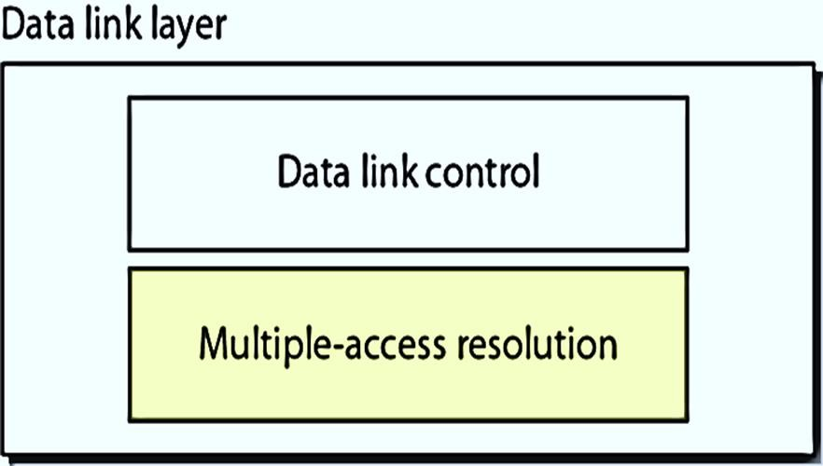
Multiple Access
Data link layer divided into two functionality-oriented sublayers
The upper sublayer is responsible for data link control, and the lower sublayer is
responsible for resolving access to the shared media
If the channel is dedicated, we do not need the lower sublayer

Slide 4
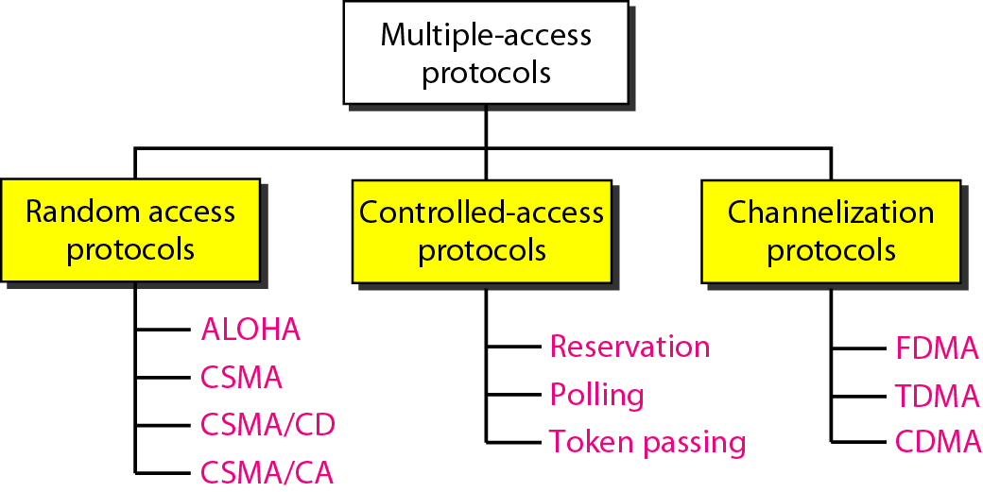
Multiple Access

Slide 5
Multiple Access →Random Access
In random access methods, no station is superior to another station and none is assigned the control over another
At each instance, a station that has data to send, uses a procedure defined by the protocol to make a decision on whether or not to send

Slide 6
Multiple Access →Random Access →Aloha
There are two different versions of Aloha
  Pure Aloha
  Slotted Aloha

Slide 7
Multiple Access →Random Access →Aloha →Pure Aloha
It allows the stations to transmit data at any time whenever they want
After transmitting the data packet, station waits for some time
The following two cases are possible
  Case 01: Transmitting station receives an acknowledgement
    Assumption: the transmission is successful
  Case 02: Transmitting station does not receive any acknowledgement within specified time
    Assumption: the transmission is unsuccessful

Slide 8
Multiple Access →Random Access →Aloha →Pure Aloha
Frame time
  The time required to send a frame is called frame time
Vulnerable time
  It is the time during which no transmission should be done to avoid any collision
  In case of Pure Aloha vulnerable time is 2T

Slide 9
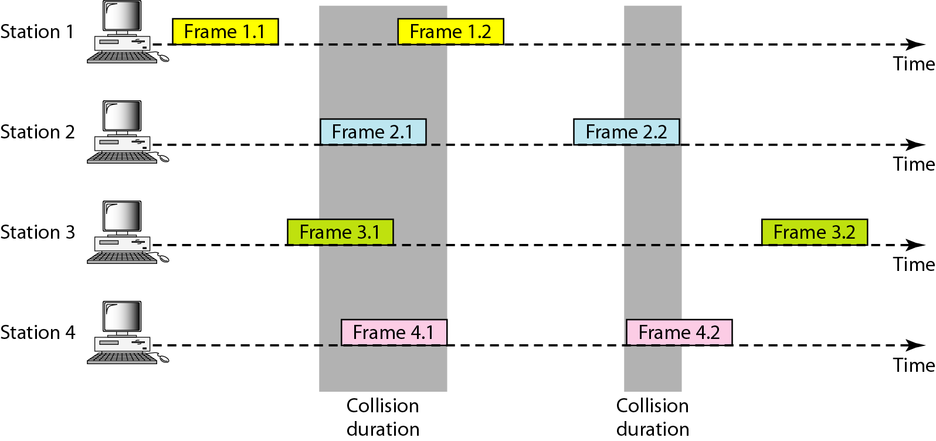
Multiple Access →Random Access →Aloha →Pure Aloha

Slide 10
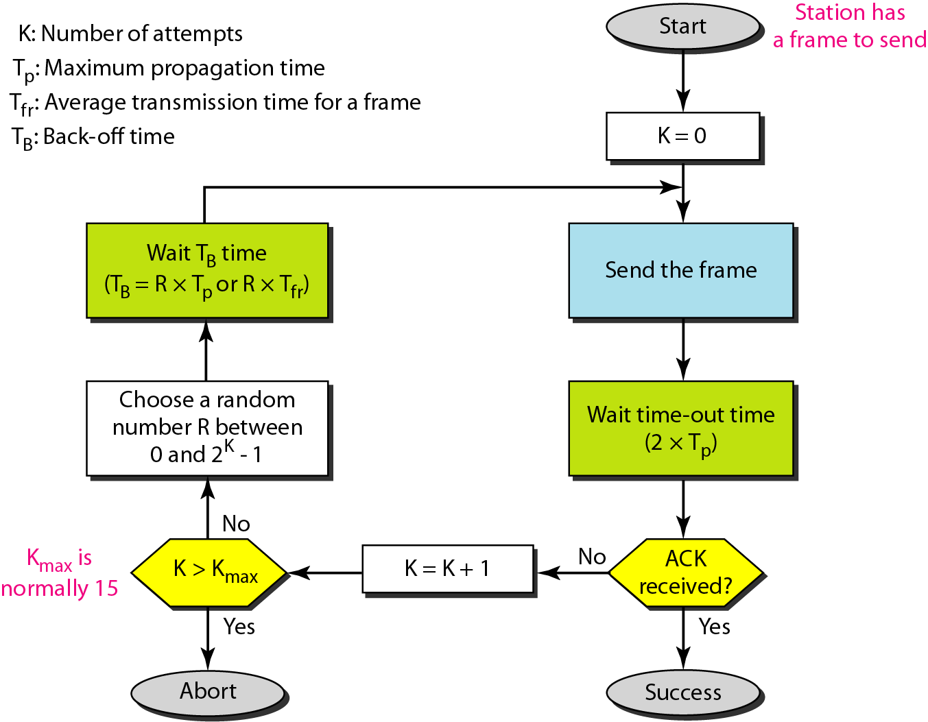
Multiple Access →Random Access →Aloha →Pure Aloha

Slide 11
Multiple Access →Random Access →Aloha →Pure Aloha
Eg:
  The stations on a wireless ALOHA network are a maximum of 600 km apart. If we assume that signals propagate at 3 × 10⁸ m/s, we find
Solution
T_{p} = (600 × 10³) / (3 × 10⁸) = 2 ms
Now we can find the value of T_{B} for different values of k
  For k = 1, the range is {0, 1}. The station needs to generate a random number with a value of 0 or 1.
  This means that T_{B} is either 0 ms (0 × 2) or 2 ms (1 × 2), based on the outcome of the
random variable

Slide 12
Multiple Access →Random Access →Aloha →Pure Aloha
The throughput for pure ALOHA is
S = G * e^{−2G}
where,
G is load

Slide 13
Multiple Access →Random Access →Aloha →Slotted Aloha
Slotted Aloha divides the time of shared channel into discrete intervals called as time slots
Any station can transmit its data in any time slot
The only condition is that station must start its transmission from the beginning of the time slot
If the beginning of the slot is missed, then station has to wait until the beginning
of the next time slot
A collision may occur if two or more stations try to transmit data at the beginning of the same time slot
However, the vulnerable time is now reduced to half, i.e. equals to T_{f}

Slide 14
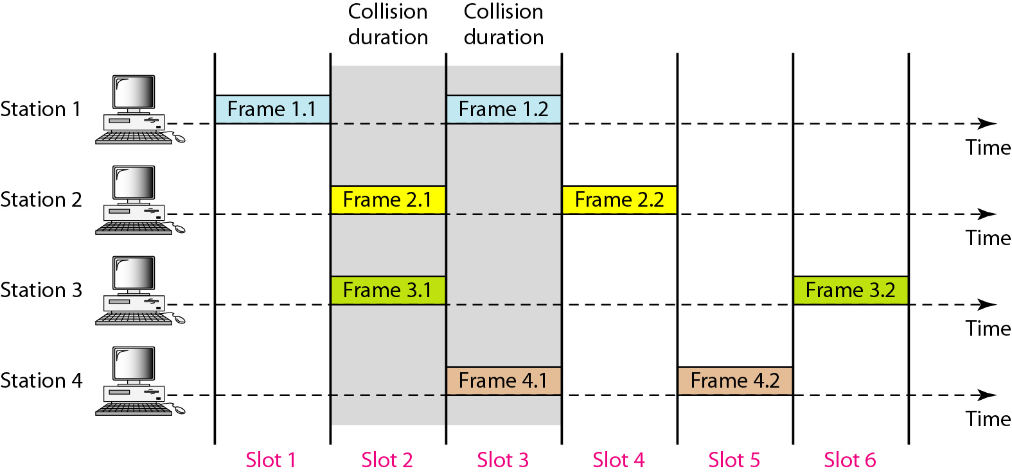
Multiple Access →Random Access →Aloha →Slotted Aloha

Slide 15
Multiple Access →Random Access →Aloha →Slotted Aloha
The throughput for slotted ALOHA is
S = G * e^{−G}
where,
G is load

Slide 16
Multiple Access →Random Access →Aloha
Eg:
– A pure ALOHA network transmits 200-bit frames on a shared channel of 200 kbps. What is the requirement to make this frame collision free
Solution
Average frame transmission time
T_{fr} = 200 bits/200 kbps
= 1 ms
Vulnerable time
= 2 * T_{fr}
= 2 x 1
=2 ms

Slide 17
Multiple Access →Random Access →Aloha
Eg:
– A pure ALOHA network transmits 200-bit frames on a shared channel of 200 kbps. What is the throughput if the system (all stations together) produces 1000 frames per second
Solution
T_{fr}= 200 bit/200 kbps
= 1 ms
If the system creates 1000 frames per second, i.e. 1 frame per millisecond, then load = 1
Throughput (S) = G * e^{-2G}
S = 0.135 (13.5 %)
Overall throughput = 1000 * 0.135
= 135 frames
Only 135 frames out of 1000 will probably survive

Slide 18
Multiple Access →Random Access →Aloha
Eg:
– A pure ALOHA network transmits 200-bit frames on a shared channel of 200 kbps. What is the throughput if the system (all stations together) produces 500 frames per second
Solution
T_{fr}= 200 bit/200 kbps
= 1 ms
If the system creates 500 frames per second, i.e. 1/2 frame per millisecond, then load = 1/2 Throughput (S) = G * e^{-2G}
S = 0.184 (18.4 %)
Overall throughput = 500 * 0.184
= 92 frames
Only 92 frames out of 500 will probably survive

Slide 19
Multiple Access →Random Access →Aloha
Eg:
– A slotted ALOHA network transmits 200-bit frames using a shared channel with a 200-kbps bandwidth. Find the throughput if the system (all stations together) produces 1000 frames per second
Solution
T_{fr}= 200 bit/200 kbps
= 1 ms
If the system creates 1000 frames per second, i.e. 1 frame per millisecond, then load = 1
Throughput (S) = G * e^{-G}
S = 0.368 (36.8 %)
Overall throughput = 1000 * 0.368
= 368 frames
Only 368 frames out of 1000 will probably survive

Slide 20
Multiple Access →Random Access →Aloha
Eg:
– A slotted ALOHA network transmits 200-bit frames using a shared channel with a 200-kbps bandwidth. Find the throughput if the system (all stations together) produces 500 frames per second
Solution
T_{fr}= 200 bit/200 kbps
= 1 ms
If the system creates 500 frames per second, i.e. 1/2 frame per millisecond, then load = 1/2 Throughput (S) = G * e^{-G}
S = 0.303 (30.3 %)
Overall throughput = 500 * 0.303
= 151 frames
Only 151 frames out of 500 will probably survive

Slide 21
Multiple Access →Random Access →CSMA
This method was developed to decrease the chances of collisions when two or more stations start sending their data
CSMA requires that each station first check the state of the medium before
sending
CSMA is based on the principle “sense before transmit”
CSMA can reduce the possibility of collision, but it cannot eliminate it
CSMA stands for Carrier Sense Multiple Access

Slide 22
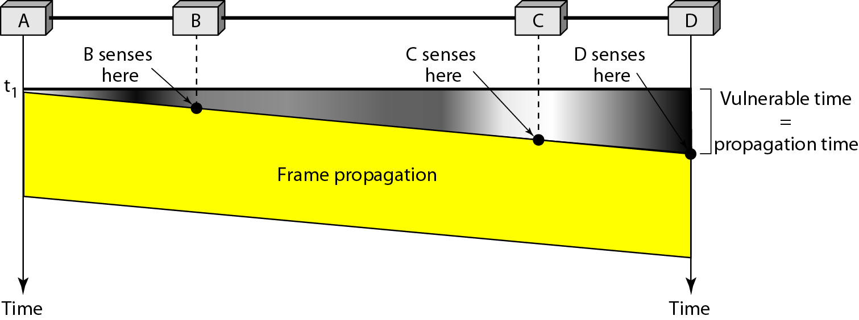
Multiple Access →Random Access →CSMA
Vulnerable Time
  The vulnerable time for CSMA is the propagation time T_{p}
  When a station sends a frame, and any other station tries to send a frame during this time, a collision will result

Slide 23
Multiple Access →Random Access →CSMA
There are three types
  1-Persistent CSMA
  Non-Persistent CSMA
  P-Persistent CSMA

Slide 24
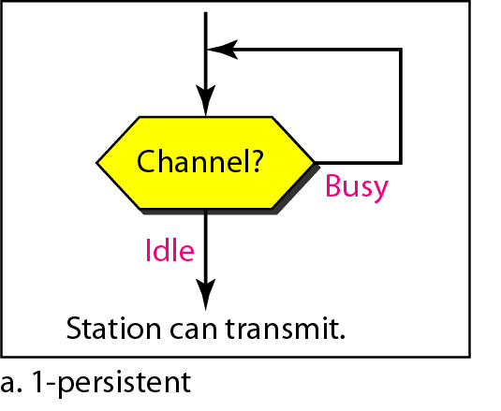
Multiple Access →Random Access →CSMA→1 persistent
If a station wants to transmit data, it continuously senses the channel to check whether the channel is idle or busy
If the channel is busy, the station waits until it becomes idle
When the station detects an idle-channel, it immediately transmits the frame with probability 1
Hence it is called 1-persistent CSMA

Slide 25
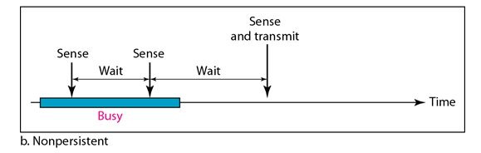
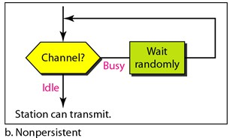
Multiple Access →Random Access →CSMA→Non persistent
A station that has a frame to send senses the channel
If the channel is idle, it sends immediately
If the channel is busy, it waits a random amount of time and then senses the
channel again
In non-persistent CSMA the station does not continuously sense the channel

Slide 26
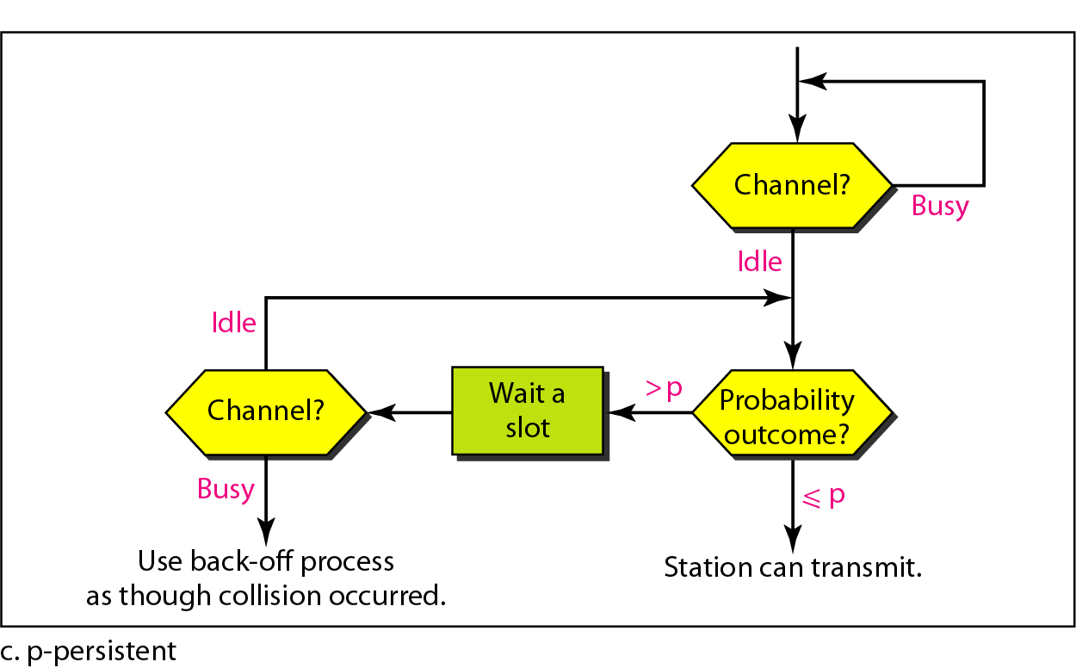
Multiple Access →Random Access →CSMA→p persistent
The p-persistent approach combines the advantages of the other two strategies
It reduces the chance of collision and improves efficiency
In this method, if the station finds the line idle, it follows these steps:
  With probability p, the station sends its frame
  The station waits for the beginning of the next time slot and checks the line again
  If the line is idle, it goes to step 1
  If the line is busy, it acts as though a collision has occurred and uses the back off procedure

Slide 27
Multiple Access →Random Access →CSMA/CD
CSMA/CD (Carrier Sense Multiple Access/ Collision Detection) is a media- access control method
CSMA/CD is one such technique where different stations agree on some terms
and collision detection measures
This protocol decides which station will transmit so that data reaches the destination without corruption

Slide 28
Multiple Access →Random Access →CSMA/CD
Step 1:
  Check if the sender is ready for transmitting data packets
Step 2:
  Sender has to keep on checking if the transmission link is idle
  Sender sends dummy data on the link. If it does not receive any collision signal, this means the link is idle, it sends the data otherwise not
Step 3:
  Sender transmits its data on the link., CSMA/CD does not use ‘acknowledgement’ system. It checks for the collision signals. During transmission, if collision signal is received, transmission is stopped. The station then transmits a jam signal onto the link and waits for random time interval before it resends the frame. After some random time, it again attempts to transfer the data and repeats above process.
Step 4:
  If no collision was detected in propagation, the sender completes its frame transmission

Slide 29
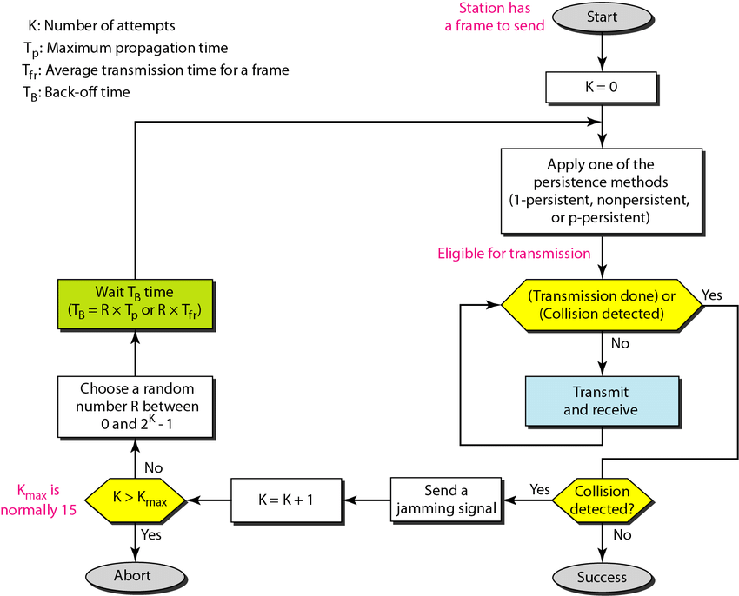
Multiple Access →Random Access →CSMA/CD

Slide 30
Multiple Access →Random Access →CSMA/CD
How a station knows if its data collides?
  Consider the situation for two stations, A and B
  Propagation Time: T_{p} = 1 hr
  At time t = 0, A transmits its data
  At t = 30 mins.: Collision occurs
  After collision occurs, a collision signal is generated and sent to both A & B to inform the stations about collision. Since the collision happened midway, the collision signal also takes 30 minutes to reach A & B
  Therefore, t = 1 hr: A & B receive collision signals. This collision signal is received by all the stations on that link

Slide 31
Multiple Access →Random Access →CSMA/CD
How a station knows if its data collides?
  Consider another situation for two stations, A and B
  At time t = 0, A transmits its data
  At t = 59:59 mins: Collision occurs
  This collision occurs just before the data reaches B. Now the collision signal takes 59:59 minutes again to reach A. Hence, A receives the collision information approximately after 2 hours, that is, after 2 * Tp
  This is the maximum collision time that a system can take to detect if the collision was of its own data
  Length of the packet = 2 * T_{p} * Bandwidth of the link
31

Slide 32
Multiple Access →Random Access →CSMA/CA
Carrier Sense Multiple Access with Collision Avoidance (CSMA/CA)
In contrast to CSMA/CD that deals with collisions after their occurrence,
CSMA/CA prevents collisions prior to their occurrence
The basic idea behind CSMA/CA is that the station should be able to receive while transmitting, to detect a collision from different stations
In wired networks, if a collision has occurred then the energy of received signal
almost doubles and the station can sense the possibility of collision
In case of wireless networks, most of the energy is used for transmission and the energy of received signal increases by only 5 – 10 % if a collision occurs. It can’t be used by the station to sense collision. Therefore CSMA/CA has been specially designed for wireless networks

Slide 33
Multiple Access →Random Access →CSMA/CA
These are three types of strategies:
  Inter Frame Space (IFS):
    The concept of an IFS allows wireless systems to implement a simple priority system. Systems with high priority data have shorter IFS times, so whenever the medium is clear they will be the first to send
  Contention Window:
    It is the amount of time divided into slots. A station which is ready to send frames chooses random number of slots as wait time
  Acknowledgements:
    The positive acknowledgements and time-out timer can guarantee a successful transmission of the frame

Slide 34
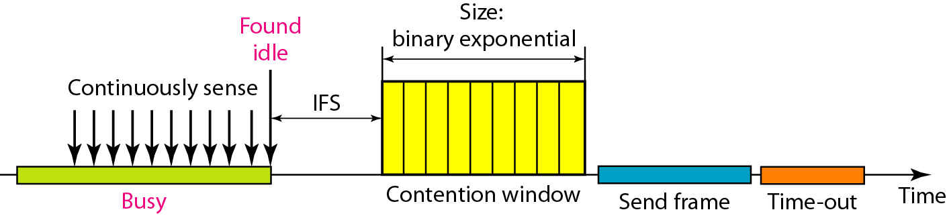
CSMA/CA

Slide 35
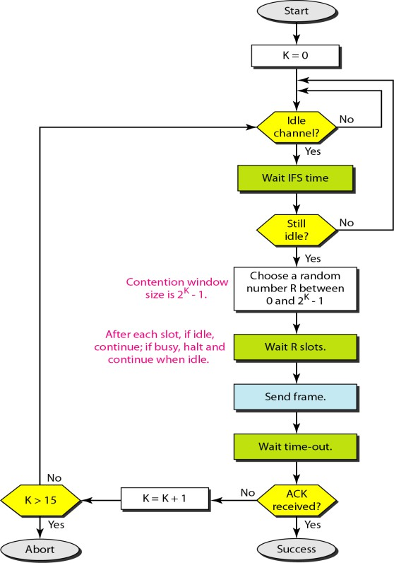
CSMA/CA
Channel idle? Don’t transmit yet!
Wait IFS time
Still idle after IFS? Don’t transmit yet! Now in Contention Window.
Choose random number and wait that many slots

Slide 36
CSMA/CA
Algorithm for CSMA/CA
  When a frame is ready, the transmitting station checks whether the channel is idle or
busy
  If the channel is busy, the station waits until the channel becomes idle
  If the channel is idle, the station waits for an Inter-frame gap (IFG) amount of time and then sends the frame
  After sending the frame, it sets a timer
  The station then waits for acknowledgement from the receiver. If it receives the acknowledgement before expiry of timer, it marks a successful transmission
  Otherwise, it waits for a back-off time period and restarts the algorithm

Slide 37
CSMA/CD - CA
Eg:
– A network using CSMA/CD has a bandwidth of 10 Mbps. If the maximum propagation time (including the delays in the devices and ignoring the time needed to send a jamming signal,) is 25.6 μs, what is the minimum size of the frame?
Solution
size of frame = 2 * propagation delay * bandwidth
= 2 * (25.6 * 10⁻⁶) * 10 * 10⁶
= 512 bits or 64 bytes

Slide 38
CSMA/CD - CA
Eg:
– In a CSMA/CD, network running at 1 Gbps over 1 km cable with no repeaters, the signal speed in the cable is 200000 km/sec. What is minimum frame size?
Solution
Propagation delay (T_{p}) = Distance/Propagation speed
= 1 km / (200000 km/sec)
= 0.5 * 10⁻⁵ sec
= 5 * 10⁻⁶ sec
Frame size = 2 * Propagation delay * Bandwidth
= 2 * 5 * 10⁻⁶ *10⁹
= 10000 bits`

Slide 39
CSMA/CD - CA
Eg:
– A 2 km long broadcast LAN has 10⁷ bps bandwidth and uses CSMA / CD. The signal travels along the wire at 2 x 10⁸ m/sec. What is the minimum packet size that can be used on this network?
Solution
Propagation delay (T_{p}) = Distance/Propagation speed
= 2 km / (2 * 10⁸ m/sec)
= 10⁻⁵ sec
Frame size = 2 * Propagation delay * Bandwidth
= 2 * 10⁻⁵ *10⁷
= 200 bits

Slide 40
CSMA/CD - CA
Eg:
– A and B are the only two stations on Ethernet. Each has a steady queue of frames to send. Both A and B attempts to transmit a frame, collide and A wins first back off race. At the end of this successful transmission by A, both A and B attempt to transmit and collide. The probability that A wins the second back off race is ?

Slide 41
CSMA/CD - CA
Solution
In 1st Transmission Attempt:
Both the stations A and B attempts to transmit a frame
collision occurs
Back Off Algorithm runs
Station A wins and successfully transmits its 1st data packet
In 2nd Transmission Attempt:
Station A attempts to transmit its 2nd data packet Station B attempts to retransmit its 1st data packet collision occurs

Slide 42
CSMA/CD - CA
Solution
Now, We have to find the probability of station A to transmit its 2nd data packet successfully after 2nd collision
After the 2nd collision, At Station A:
2nd data packet of station A undergoes collision for the 1st time So, collision number for the 2nd data packet of station A = 1
Now, station A randomly chooses a number from the range [0, 2¹-1] = [0, 1]
Then, station A waits for back off time and then attempts to retransmit its data packet
At Station B:
1st data packet of station B undergoes collision for the 2nd time So, collision number for the 1st data packet of station B = 2
Now, station B randomly chooses a number from the range [0, 2²-1] = [0, 3]
Then, station B waits for back off time and then attempts to retransmit its data packet

Slide 43
CSMA/CD - CA
Solution
Following 8 cases are possible
From here,
Probability of A winning the 2nd back off race
= 5/8
= 0.625
Station A | Station B | Remark
0 | 0 | Collision
0 | 1 | A wins
0 | 2 | A wins
0 | 3 | A wins
1 | 0 | B wins
1 | 1 | Collision
1 | 2 | A wins
1 | 3 | A wins

